Slide 1
Employee Data Analysis using Excel
STUDENT NAME: RAMYA.S
REGISTER NO: 312210045
NM NO:63D7343A8C72EBFB9D94959710276AC2
DEPARTMENT:BCOM GENERAL
COLLEGE: VALLIAMMAL COLLEGE FOR WOMEN

Slide 2
PROJECT TITLE
Employee Performance Analysis using Excel

Slide 3


AGENDA
Problem Statement
Project Overview
End Users
Our Solution and Proposition
Dataset Description
Modelling Approach
Results and Discussion
Conclusion
3/21/2024 Annual Review

Slide 4

PROBLEM STATEMENT
Analyze the salary distribution within the engineering
department to identify trends, gender disparities,and the impact of employment type and work location on salaries

Slide 5

PROJECT OVERVIEW
This project analyzes employee data within the Engineering department , focusing on key metrics such as salary, employment type,work location, and tenure to uncover key work force insights.

Slide 6

WHO ARE THE END USERS?
The end users of this project are likely HR professionals,departmentmanagers,and company executives who are responsible for work force planning,salary management,and employee retention strategies within the Engineering department.

Slide 7

OUR SOLUTION AND ITS VALUE PROPOSITION
A dynamic salary bench marketing tool can be implemented to automatically compare employee salaries with industry standars and regional costs. This solution helps ensure competetive compensation,aiding in talent retention and aligning payroll with market trends.

Slide 8
Dataset Description
The dataset includes employee records from the Engineering department ,covering details like salary,employment type ,FTE, and work location. This information is used to analyze salary patterns and workforce distribution across different roles and religions.

Slide 9
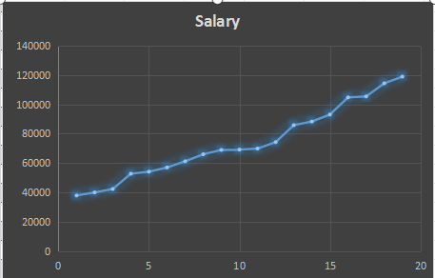

THE "WOW" IN OUR SOLUTION
3/21/2024 Annual Review
9

Slide 10
MODELLING
The model helps to understand the influence of each factor on salary ,providing valuable insights into the determinants of employee compensation within the organization.The basic analysis serves as starting point for deeper exploration and decision making.
10

Slide 11
RESULTS
11

Slide 12
conclusion
The data in the spreadsheet appears to show employee details ,including their salaries, it indicates an upward trends in salaries ,suggesting that you move down the l;ist of employees, their salaries generally increase. This might imply that higher- ranking positions or more experienced employees have higher salaries.

